Slide 1
Customer Prediction Model: Accuracy and Performance
Overview of customer prediction model performance, demonstrating key metrics and insights.
DS
by Damilare Segun

Slide 2
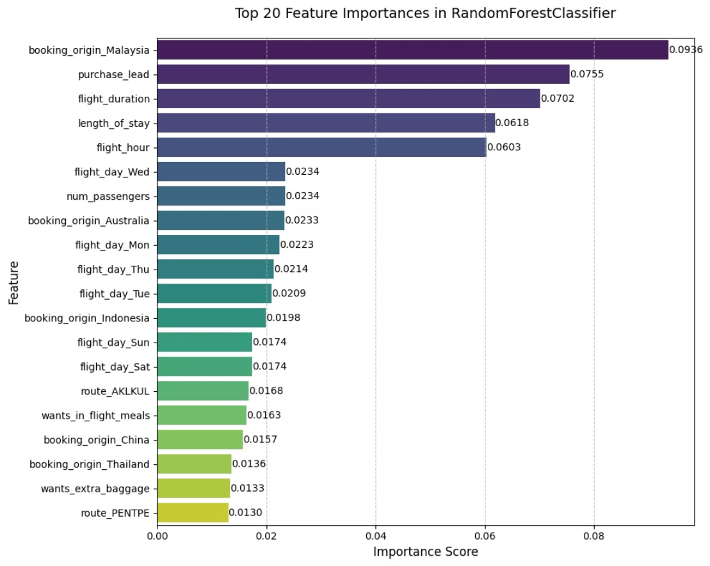

Slide 3
Model Performance Metrics
Accuracy
Precision
Recall
F1-Score
0.8419
Class 0: 0.87
Class 0: 0.95
Class 0: 0.91
Class 1: 0.44
Class 1: 0.20
Class 1: 0.28

Slide 4

Results and Next Steps
1
High Accuracy
2
Class Imbalance
3
Next Steps
The model demonstrates strong overall accuracy, indicating its ability to correctly classify customers.
Notable class imbalance impacts precision and recall for Class 1, indicating potential need for further refinement. I used bootstrapping as part of my hyperparameter tuning.
Further analysis, data exploration, and potential model adjustments to address class imbalance and enhance predictive power.

